Slide 1

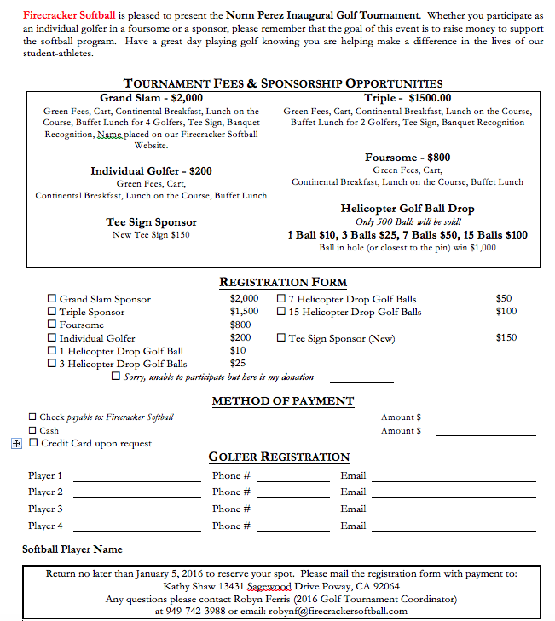
Norm Perez
Inaugural Golf Tournament
January 25, 2016 at Black Gold Golf Club
Registration: 6:30 a.m. ♦ Shot gun Start: 8:00 a.m.
Lunch/Awards/Raffles: 2:00 p.m.

